Slide 1
States and Societies of Sub-Saharan Africa
Chapter 18
AP World History
Notes
Traditions and Encounters AP Edition 2017-18

Slide 2
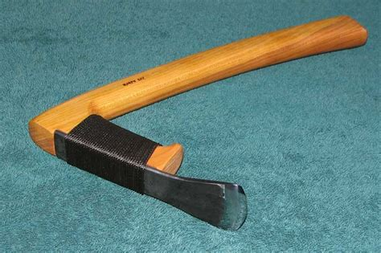
Agriculture And Population Growth
Bantu migration‘s
Result:
Spread of agriculture and herding
Bantu Peoples
By 500 B.C.E.
mastered
Iron Metallurgy
Made axes Adzes, & Hoes

Slide 3
Agriculture And Population Growth
South Africa
Staples: yams, sorghum, millet
Bananas introduced
First domesticated in southeast Asia
Came to Africa by Malay seafarers who colonized Madagascar
Brought bananas, Asian yams, Taro

Slide 4
Agriculture And Population Growth
Result: increase the supply of food
increase in population
more iron working and more bananas
Large Communities made it difficult for Forest Dwellers.
Some join Bantu society
Some went further into the forest

Slide 5
Political Organization
Kin Based Societies
Stateless or sedimentary societies
No hierarchy or bureaucracy
Governed themselves through family and kinship groups
Bantu villages
100 people
ruling council
heads of families (Males)
District - a group of villages
Some grew quite large
EX: Tiv of Nigeria – 1 Million People
Notes:
P 385

Slide 6
Political Organization
Jenne – Jeno 400- CE
Bantu speaking
Niger river
Urban society
Used Iron tools
Center of iron production and trade
Traded
Iron, rice, fish, domesticated animals
Ex: cattle, sheep and goats
Notes:
P 385

Slide 7
Political Organization
Chiefdoms
After 1000 CE
Kin based society’s had issues
Strained resources
Result:
Created Conflicts with surrounding peoples
Result:
Created militaries
More formal governments
Small kingdoms Ife In Benin
Both city states
Both produced magnificent sculptures
Notes:
P 385

Slide 8
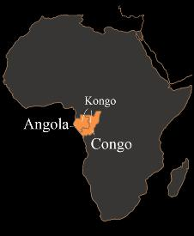
Political Organization
Kingdom of Kongo
Congo River basin
Active in trade networks
Traded: Copper Raffia cloth, nzimbu shells
Centralize government
Notes:
P 385

Slide 9
Kingdom of Kongo Social Structure
_ Kings
_Officials
_governors
_subordinate officials
_ Chiefs
In charge of the military, the judicial and the financial
Kingdom was broken up into 6 providences and ruled by a governor
Ruled Villages
Notes:
P 385

Slide 10
Islamic kingdoms and empires
Merchants from north Africa and southwest Asia brought Islam to the sub-Saharan
Islam influenced political, social, and economic development
Notes:
P 385

Slide 11
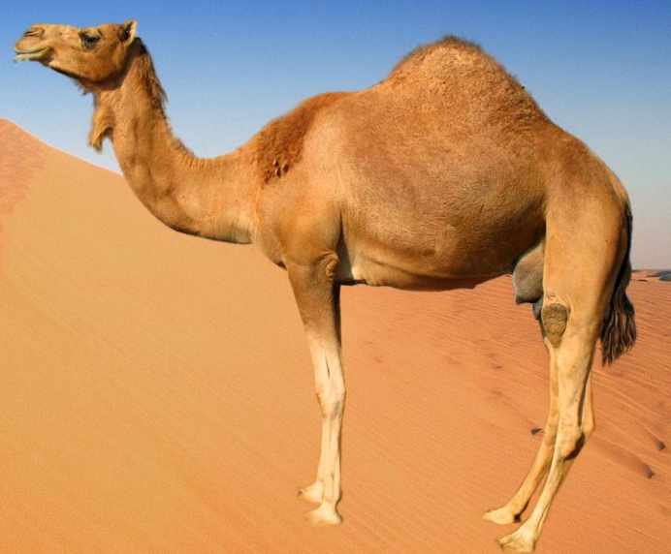
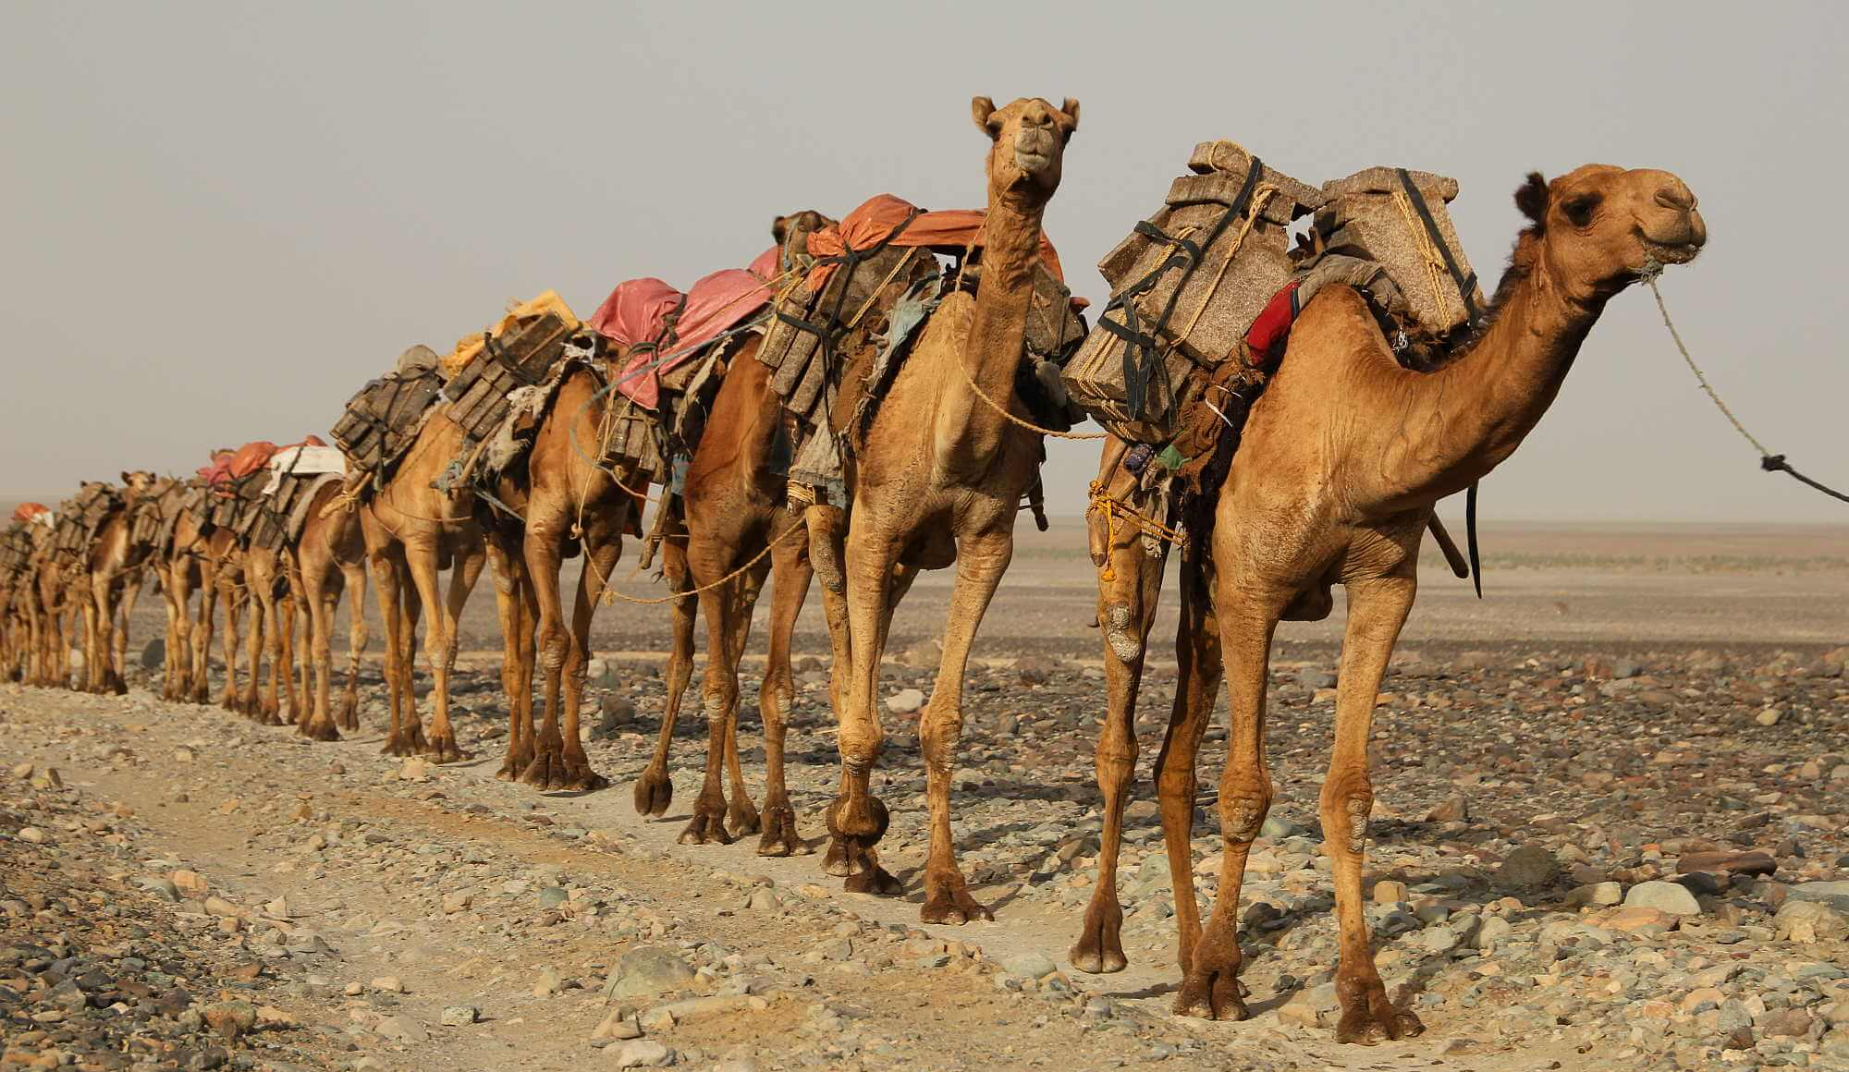
Islamic kingdoms and empires
Camels
Sped up communication & transportation
Took 70 to 90 days to cross the Sahara desert
By late 8th century Islamic merchants across the desert
establish commercial relationships with the sub-Saharan peoples in west Africa
Notes:
P 385

Slide 12
Ghana
Kingdom not an empire
Pre-dates of Muhammed
Made their money with gold trade
most important commercial site in west Africa
Why? Center of gold Trade
Exported: gold, ivory, and slaves
Imported: horses, cloth and salt

Slide 13
Ghana
Islam in west Africa
10th-century kings converted to Islam
Do not force subjects to convert
Some convert by choice
Combined with local traditions
Result:
Better relationship with Muslim traders

Slide 14
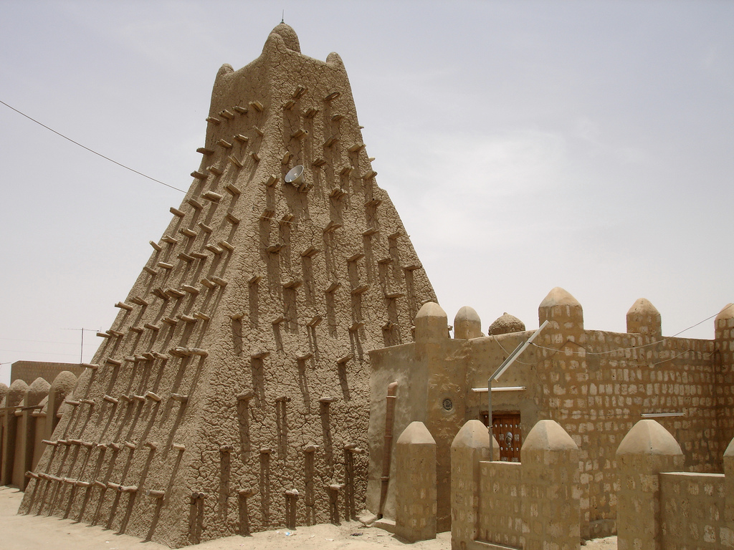
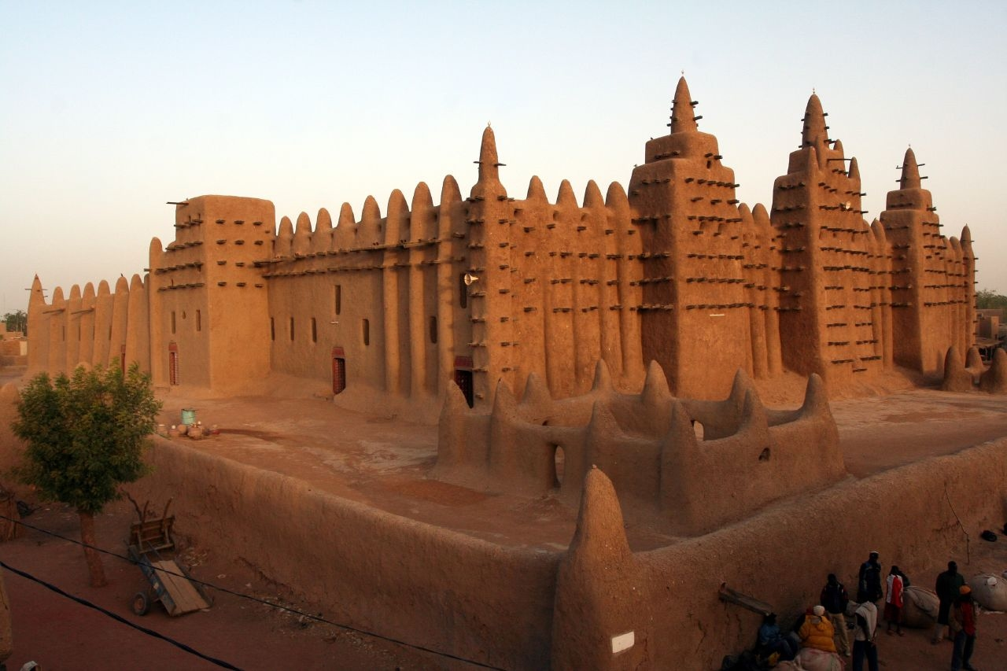
Mali Empire
Sundiata
Ist Mali 1230-1255
Benefited from Gold and Salt trade – more than Ghana
Capital Niani

Slide 15
Mali Empire
Mansa Musa
2ndf Great Mali Ruler 1312-1337
Islamic
Pilgrimage 1324-1325
Distributed so much gold its value declined by 25 percent
Build mosques,
Send promising students to study and north Africa
Mali Fell -Pressure for militaries Desert nomads

Slide 16
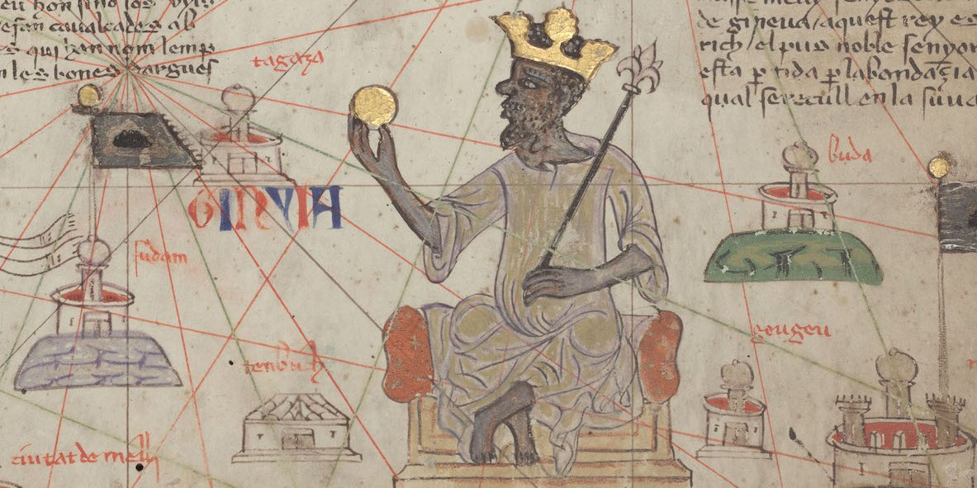
Mansa Musa

Slide 17
Mali Empire
Trans-Saharan Trade and Indian Ocean Trade linked west Africa to the eastern hemisphere

Slide 18
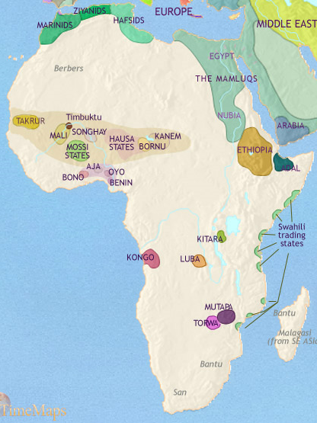
The Swahili Societies
By 2nd Century
Bantu peoples populated much of East Africa
Introduced: Agriculture, Cattle herding, Iron metallurgy
Spoke Swahili
Swahili = Arabic + Bantu

Slide 19
The Swahili Societies
Exports:
Interior of Africa: gold, slaves, ivory and exotic items
EX: tortoise shell‘s and leopard skins
Imported:
pottery , glass and textiles
Made money through taxing trade

Slide 20
The Swahili Societies
Swahili city states
11th and 12th century
tremendous wealth on the east coast of Africa
controlled tax and trade
Cities developed into powerful city-states
Buildings of coral And stone
elites dressed in silk

Slide 21
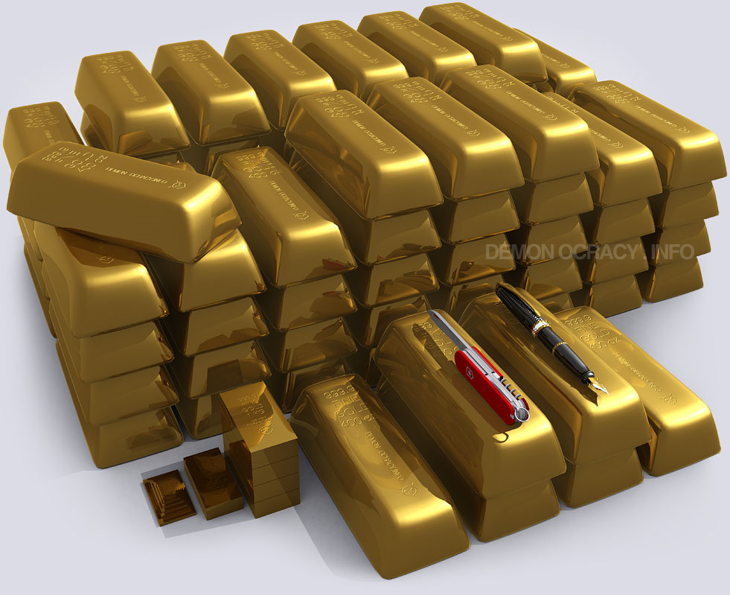
The Swahili Societies
Kilwa
one of the busiest cities-states on the East African coast
By the 13th century
had multifloor stone buildings
Imported: Cotton, silk, perfumes, pearls and Chinese porcelain
Exported: Gold, slaves, and ivory
About one ton of gold per year

Slide 22
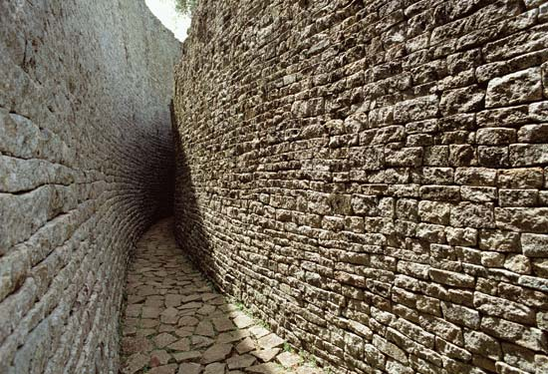
The Swahili Societies
Zimbabwe
Great Zimbabwe
Controlled gold and salt trade
Disappeared
Not sure why.

Slide 23
Islam in East Africa
Mainly Ruling elites and Merchants
Combined African Traditions
Close relationship with Indian ocean Muslim Traders
Islam eventually became one of the principal cultures and religious traditions of East Africa

Slide 24
African society and cultural development Sub-Saharan Africa
800 different languages
Hunters and gatherers
Fishing – coast and legs
Nomadic herders
Farmers – migrated for new land
Settled cultivators
City based society’s
People worked as miners, manufacturers and traders

Slide 25
Social Classes
Sub-Sarahan Africa
Kinship
small agricultural villages
did not recognize private ownership of land
Male heads of families govern

Slide 26
Sex and gender relations
Skilled labor was mainly men
Kept trade secrets
Blacksmiths often were community leaders

Slide 27
Woman's Roles
Higher than counter parts another places
Why?
Honored as a source of life
Sometimes held positions of power
Could influence politically
Women merchants participated in local and long-distance trade
Some Engaged in combat - Some all female fighting units

Slide 28
Woman's Roles
Islam did not really affect the status of women very much
Why?
Did not Honor same social code
On some societies elite women wore veils and were secluded

Slide 29
Slavery
Most slaves were captives of war
Others: Debtors, suspected witches, Criminals
In Africa, slaves mainly used for agricultural labor
Could do construction, mine or porters
Slaves If current form of personal wealth Why Little private ownership of land Build wealth through slave labor Slaveholding in trading was a prominent feature of sub-Saharan Africa
Slaves form of personal wealth
Why?
Little private ownership of land
Build wealth through slave labor and Slaveholding
Slave raiding a prominent feature of sub-Saharan Africa

Slide 30
Slavery
Slave trading
India Persia and southwest Asia and the Mediterranean basin had a demand for slaves
Formally slaves came from Eastern Europe
Slavs =slaves
Slave Raiding
Bigger larger states took advantage of smaller for slaves
Islamic Slave trade – about 10,000,000 exported

Slide 31
African Religion
Believed in creator God
Creator God:
sustains the world intervening indirectly through spirits
Diviner – (Priests)
Lesser gods

Slide 32
African Religion
Believed in creator God
Creator God:
sustains the world intervening indirectly through spirits
Have lesser gods
Diviner – (Priests)
Connect the human to the supernatural
Focus: explain, predict and control

Slide 33
Early Christians in North Africa
Kingdom of Axum
4th Century Christian
Merchants & Kings converted
converted by missionaries
What was the draw?
to improve relations with Christian Egypt
Not really in contact with other Christians
Missionaries established monasteries
Translated Bible into Ethiopian language
Christianity was around until The socialist revolution in 1974
Ethiopian Christianity combined with local beliefs

